Slide 1
Installation Guide

Slide 2
Packages
Git
Python
OpenAI Gym (Gym, Matplotlib, JSAnimation)
Jupyter

Slide 3
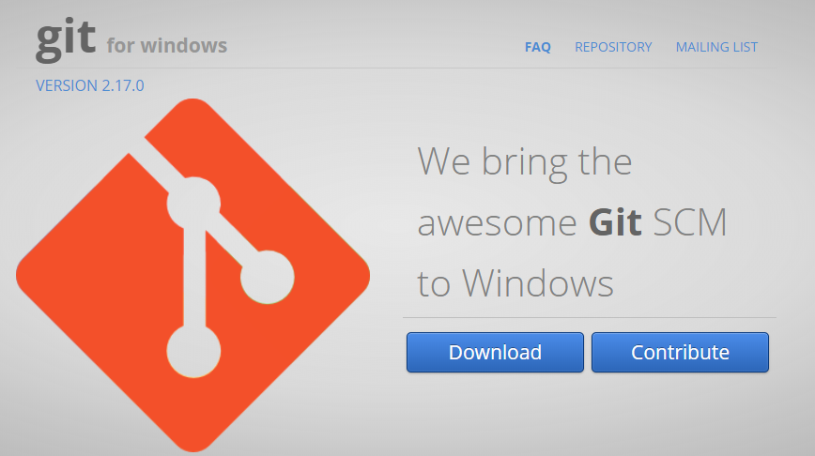
Git
sudo apt-get install git
https://gitforwindows.org/

Slide 4
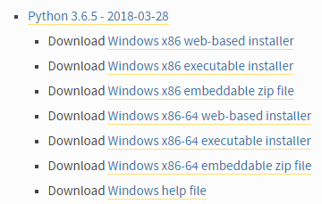
Python
https://www.python.org/downloads/windows/

Slide 5
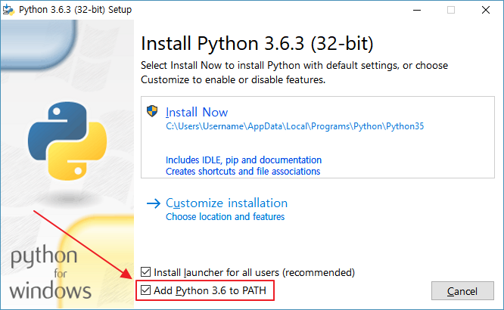
Python
https://www.python.org/downloads/windows/

Slide 6
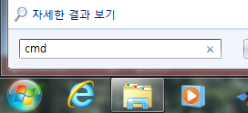
Pip
pip3 install --upgrade pip
[Error: pip3 not found]
sudo apt-get update
sudo apt-get -y install python3-pip
cmd
pip3 install --upgrade pip

Slide 7
OpenAI Gym
sudo apt-get install -y python-numpy python-dev cmake zlib1g-dev libjpeg-dev xvfb libav-tools xorg-dev python-opengl libboost-all-dev libsdl2-dev swig
git clone https://github.com/openai/gym
cd gym
sudo pip3 install -e .[all]
git clone https://github.com/openai/gym
cd gym
pip3 install -e .

Slide 8
matplotlib
sudo pip3 install matplotlib
pip3 install matplotlib

Slide 9
JSAnimation
git clone https://github.com/jakevdp/JSAnimation
cd JSAnimation
python setup.py install
git clone https://github.com/jakevdp/JSAnimation
cd JSAnimation
python setup.py install

Slide 10
Jupyter
pip3 install jupyter
pip3 install jupyter

